Slide 1
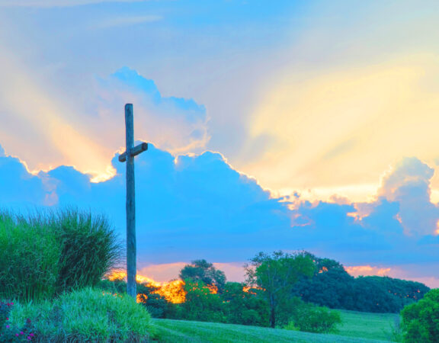

Slide 2
Quick Recap!
What is Building Hope?
A Diocesan Call to Renewal.
Resource to plan for the future with creativity and hope.
Resource to ensure collaboration and co-responsibility within our church
Now we are in the action phase of Building Hope across the diocese.
Mission: Being at the service of the encounter with Jesus across the diocese
Vision: We are called to develop new ways to accompany people within the reality of our current context. We will do this through prayer, discernment, and decision-making, concerning our missionary priorities.

Slide 3
The Pillars of Building Hope across the diocese to build thriving faith communities are:
Welcome and Inclusion
Faith Filled
Servant Leadership
Social Justice

Slide 4
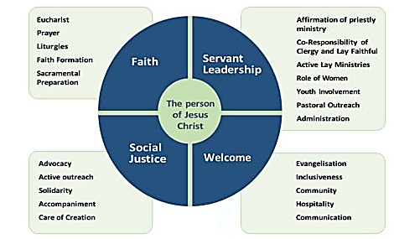
The Pillars of Building Hope
The Acts of the Apostles describes vibrant faith communities under the dimensions of faith, servant leadership, welcome and social justice.
The consultation results established a wheel of focus areas, centered on Christ

Slide 5
Our Pastoral Planning Cycle:
Pray – Why come together to pray?
Reflect – What needs prayer and reflection?
Plan – How to use Pastoral Planning Resource

Slide 6
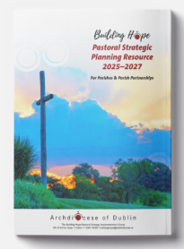
Step by Step
“Let us find our way, step-by-step, working more deeply together, as we build our partnerships of parishes, embracing the road the Spirit is bringing us on.” ~ Building Hope Document
A series of Monthly focuses:
Welcome and Inclusion - July
Faith – August
Servant Leadership – September
Social Justice - October
We need your feedback, your planning, your prayer!

Slide 7
To close we ask everyone to pray for Building Hope initiatives in the partnership and for our parish renewal. Across the partnership we are calling parishioners to please pray for the future of our parish using the Building Hope Prayer
The Building Hope Prayer
May the risen Christ sow seeds of hope and new life deep within us. May our hearts and minds be filled with your Word, bringing forth truth, justice and peace. May the Holy Spirit working in and through us do much more than we can dare to imagine as we live out our baptismal calling in humble and loving service. We make this our prayer through Christ Our Lord. Amen.
Mary, Mother of the Church, pray for us.
St Laurence O’Toole, pray for us.
St Kevin, pray for us. St Brigid, pray for us.
St Cronan, pray for us. St Finian, pray for us.
St Patrick, pray for us. St Ita, pray for us.
St Colmcille, pray for us.

