Slide 1
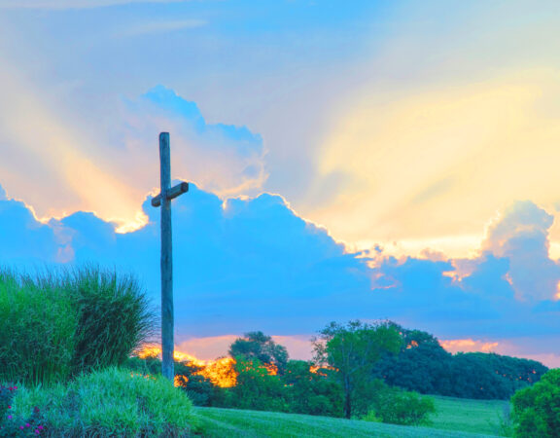

Slide 2
What is Building Hope?
A Diocesan Call to Renewal.
Resource to plan for the future with creativity and hope.
Resource to ensure collaboration and co-responsibility within our church
Building Hope consultation was held across the diocese.
3,000 people, mostly lay faithful, responded to our invitation
Now we are in the action phase of Building Hope across the diocese.
Mission: Encounter with the Person of Jesus makes us who we are, and shapes what we do. Being at the service of this encounter is the heart of our mission

Slide 3
The themes which emerged from the Building Hope consultation demonstrated the many facets of hope to be found in the life of the Church:
liturgy
faith formation
community
prayer
leadership
social justice initiatives
These themes provide a framework for the development of a pastoral strategy.

Slide 4
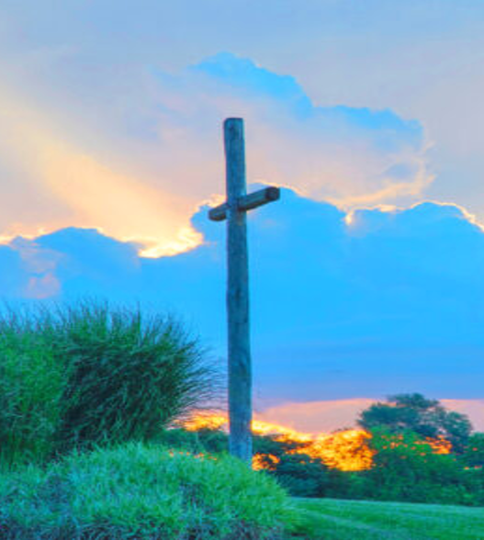
Hope
Our Hope in Christ orientates Christians towards the future. Hope demands honesty about past failings and scars. Hope as realism, faithfulness and imagination counters nostalgia, denial, and conformity, which distract us from a brighter future.
In today’s world our Christian hope is Solid. This frees us, to be ambitious, to be brave. It is a new beginning
In all we plan together, we have to remain open to the
Spirit, and listening to where the Spirit is calling us.
True hope is best experienced
when we support each other.

Slide 5
Why the Urgency of the Building Hope 2025-2027 Strategy?
Reality check - We are facing many big challenges:
Reducing number of priests
Ageing church
The number of volunteers is not sustainable
Financial challenges
The current path, existing structures and practices will lead to collapse.
Co-responsibility is key!
We need to be brave in reimagining our Church, to inspire and support a living faith in a secularized society. We have an opportunity to recommit to the renewal of the Church in its mission to reveal God’s love in Christ.
“Let us look at the Church – and the world – with the eyes of God. Smallness is not an end-point, but a beginning. This is how the church began. It is always how the Church begins” ~ Building Hope Strategic resource

Slide 6
Vision of Building Hope: We are called to develop new ways to accompany the people of our time. This will require a shift of mind-set in everyone. Within the reality of our cultural, social and church context, we must create new possibilities for mission. Aware of the need for responsible stewardship, and of the diminishing resources available of time, talent and treasure, we enter an ongoing process of prayerful dialogue, discernment and decision making, concerning our missionary priorities.
The Building Hope Prayer
May the risen Christ sow seeds of hope and new life deep within us. May our hearts and minds be filled with your Word, bringing forth truth, justice and peace. May the Holy Spirit working in and through us do much more than we can dare to imagine as we live out our baptismal calling in humble and loving service. We make this our prayer through Christ Our Lord. Amen.
Mary, Mother of the Church, pray for us.
St Laurence O’Toole, pray for us.
St Kevin, pray for us.
St Brigid, pray for us.
St Cronan, pray for us.
St Finian, pray for us.
St Patrick, pray for us.
St Ita, pray for us.
St Colmcille, pray for us.

